Slide 1

Juvenile Justice System
.

Slide 2
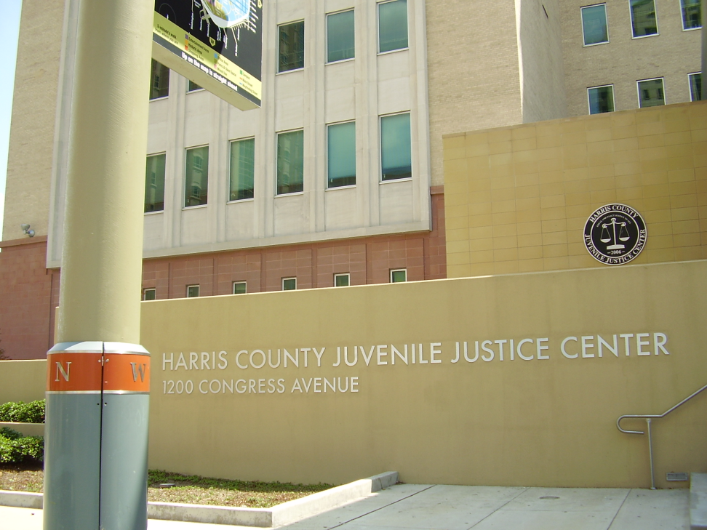
Juvenile system explained
Area of criminal law applied to people under eighteen years.
Criminal culpability age is eighteen years.
Enacted by a juvenile code.
The four components that differ from adult system include age of the youth, legislative component, court structures and statues that define offences (Steinberg, 2017).
Notes:
The juvenile justice system mirrors the adult justice system although in this case it is applied to persons who are not old enough to be responsible for criminal acts. Juvenile justice system ensures public safety, addresses treatment needs, rehabilitates and ensures smooth reintegration of youth into the community. The system differs from the adult system because it uses different statues in defining offences, applies the youth component and has different court structures and officers.

Slide 3
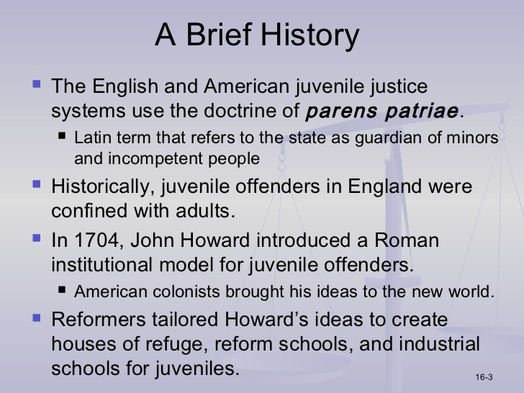
Establishment of Juvenile Justice System
Established over 100 years ago.
Initially, the system focused on children or adolescents in need of help.
It rarely focused on the act that led the child to court.
Since they were children, rights to confront the accuser, trial by jury or knowing the charges were seen as unnecessary components of the process.
Language was different.
The charges were not criminal acts but delinquencies.
When the kids were adjudicated delinquents, they were taken to training schools and reformatory centers (Steinberg, 2017).
Notes:
Juvenile justice system differed in many instances when compared to the adult justice system. The language used in the juvenile version is different. The kids are not criminals but delinquents. They are not found guilty but are adjudicated delinquents. They are taken to training centers or reformatory centers. The proceedings are closed to the public to protect the child.

Slide 4
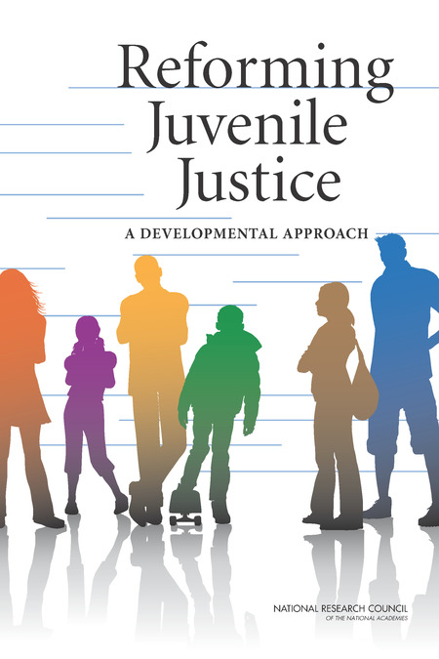
Dilemmas in juvenile justice
In practice, there was a lot of tension between social welfare and social control.
Increase in violent criminal activities in the 1980s led to more punitive and accountability measures ((Feld, 2018).
A dilemma exists between holding adolescents responsible and the changes they undergo at that age.
Notes:
Delinquency can be brought about by factors like history of criminal behavior, chronic school failure, mental illness and drug use, bullying on social media and at school and experiencing trauma. These factors make judging children more complex because they create an interconnected web that questions accountability.

Slide 5
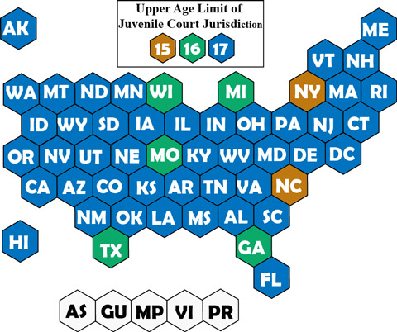
Age
Most states believe children from 15 years of age can commit criminal acts (Steinberg, 2017).
41 states set juvenile age at 17.
In Wisconsin, South Carolina, Louisiana, Michigan, Georgia, Missouri and Texas have set it at 16.
North Carolina and New York have set it at 15.
Incarceration is the most common form of punishment (Steinberg, 2017).
Notes:
Although 18 years is the age when children become adults, criminal activities go way back to age 15 in some states, which means the children are seen to be accountable of their actions. Increase in delinquency and violence led to this change in states that use it. most of the other states use age 16 and 17. To keep the public safe, these ages are reviewed every now and then and changed.

Slide 6
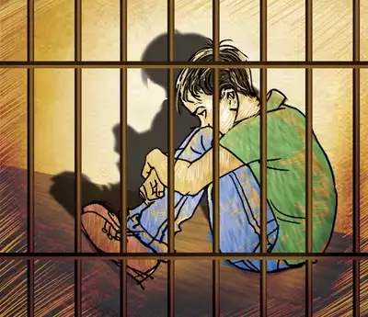
Common crimes
Vandalism and graffiti
Shoplifting
Simple assault
Theft larceny
Underage drinking
Fraud, forgery an counterfeiting
Notes:
Most juvenile crimes are seen as misdemeanor crimes. They are also first time offenses, which lowers the weight given to criminal activity. Vandalism and graffiti are not seen as violent crimes since they can be rehabilitated easily.

Slide 7
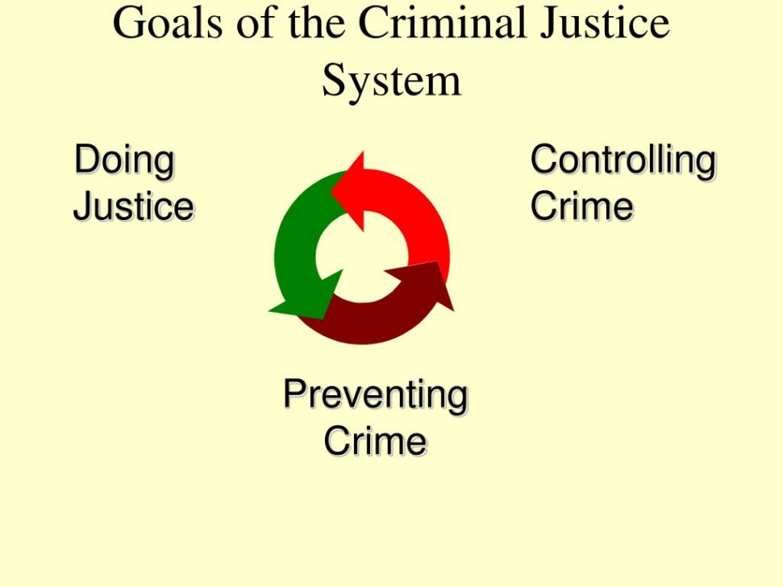
Goals
Retribution
Deterrence
Incapacitation
Rehabilitation
Restoration
Notes:
Families of victims always call from retribution, which is one of the reasons the justice system exists. Deterrence helps prevent future crimes and discourages other children from engaging in such practices. Incapacitation prevents the offender from mingling with the society before rehabilitation. Rehabilitation is aimed at making the child a better person before they go back into the society.

Slide 8
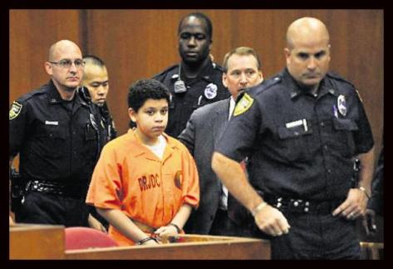
Differences between the adult system and juvenile system
Adults commit crime while juveniles commit delinquent acts (Feld, 2018).
Juveniles undergo adjudication instead of a public trial.
The goal of adult system is to punish while that of juvenile is to rehabilitate.
Juvenile courts are informal yet adult courts are formal.
Rules about admission of evidence are lenient in juvenile.
Notes:
The language used in juvenile justice system is different because the goals are different when compared to the adult criminal justice system. The children can be more accepting of rehabilitation if they are not referred to as criminals or guilty.

Slide 9
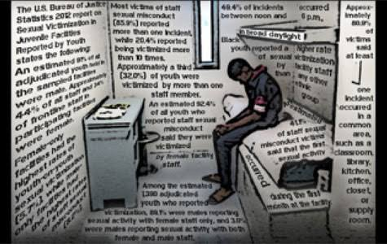
Is it effective or necessary?
It is necessary because it provides public safety.
It is effective because it provides skills, habilitation, rehabilitation and treatment options.
Notes:
Some children commit offences because of psychological and mental issues. Juvenile justice system gives these kids rehabilitation an treatment at the right time. Since the goal is to rehabilitate, children stand a better chance of getting well.

Slide 10
References
Feld, B. C. (2019). The evolution of the juvenile court: Race, politics, and the criminalizing of juvenile justice (Vol. 4). NYU Press.
Steinberg, L. (2017). Adolescent brain science and juvenile justice policymaking. Psychology, Public Policy, and Law, 23(4), 410.
Wilson, D. B., Olaghere, A., & Kimbrell, C. S. (2018). Effectiveness of restorative justice principles in juvenile justice: A meta-analysis. Inter-university Consortium for Political and Social Research.

